Slide 1



STUDIO SHODWE
HOME
SERVICE
ABOUT US
CONTACT US
PITCH DECK
Free Template Presentation
A presentation is a formal talk, often delivered in front of an audience, aimed at conveying information, persuading others, or sharing insights on a particular topic. Presentations can take various forms, such as verbal speeches, slideshows, demonstrations, or multimedia displays.
WWW.REALLYGREATSITE.COM

Slide 2



STUDIO SHODWE
HOME
SERVICE
ABOUT US
CONTACT US
INTRODUCTION
A presentation is a formal talk, often delivered in front of an audience, aimed at conveying information, persuading others, or sharing insights on a particular topic. Presentations can take various forms, such as verbal speeches, slideshows, demonstrations, or multimedia displays.
They are commonly used in academic, professional, and social settings to communicate ideas, proposals, reports, or findings. Effective presentations typically involve careful planning, organization, and delivery techniques to engage the audience and effectively convey the intended message.

Slide 3
STUDIO SHODWE
HOME
SERVICE
ABOUT US
CONTACT US
PROBLEM
Outdated Investor Databases
Spam and Inefficient Outreach
Startup founders struggle with accessing current and accurate VC contact information.
Finding relevant investors and avoiding spam is time-consuming and inefficient for founders.

Slide 4

STUDIO SHODWE
HOME
SERVICE
ABOUT US
CONTACT US
OUR SOLUTION
AI-Powered Investor Search
An AI engine provides a curated list of relevant investors, eliminating outdated data and spam.
AI-Generated Pitch Decks
AI assists founders in creating professional and compelling pitch decks, saving time and resources.

Slide 5


STUDIO SHODWE
HOME
SERVICE
ABOUT US
CONTACT US
MARKET OPPORTUNITY
Large Startup Market
Improved Funding Success Rates
A massive number of startups constantly seek funding, representing a large potential user base for the platform. This need for efficient investor connections fuels high demand.
By connecting founders with highly relevant investors and providing superior pitch materials, the platform increases chances of securing funding.
Recurring Revenue Model
Premium Data Advantage
Subscription-based access to the AI tools ensures a predictable and scalable revenue stream for the platform, fostering sustainable growth.
The platform differentiates itself by providing high-quality, reliable investor data and contact information, a significant advantage over existing solutions.

Slide 6

STUDIO SHODWE
HOME
SERVICE
ABOUT US
CONTACT US
Business Model
The platform operates on a subscription model, charging users a fee for access to its AI-powered investor search engine and pitch deck generation tools. This provides a recurring revenue stream while delivering significant value to startup founders seeking funding.

Slide 7
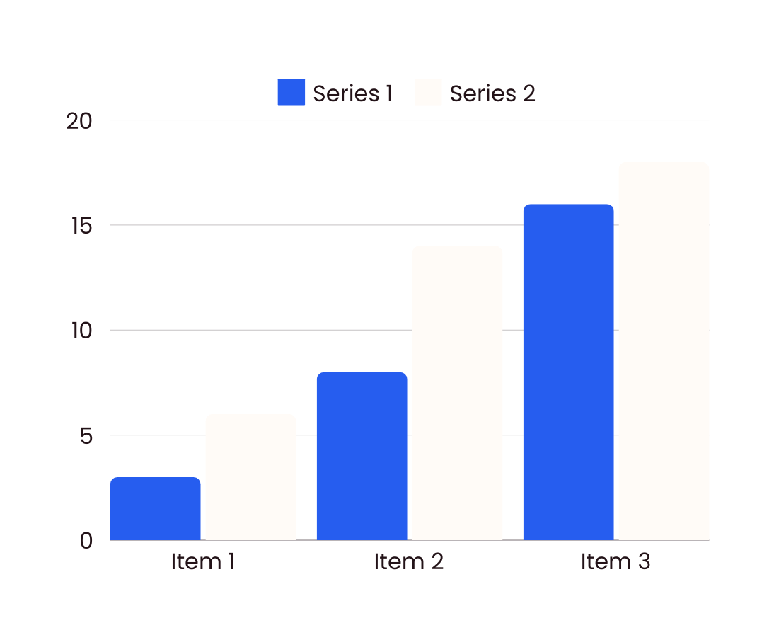
STUDIO SHODWE
HOME
SERVICE
ABOUT US
CONTACT US
FINANCIAL PROJECTIONS
A presentation is a formal talk, often delivered in front of an audience, aimed at conveying information, persuading others, or sharing insights on a particular topic. Presentations can take various forms, such as verbal speeches, slideshows, demonstrations, or multimedia displays.
Operational expenses
Marketing budgets
A presentation is a formal talk, often delivered in front of an audience, aimed at conveying information, persuading others, or sharing insights on a particular topic.
A presentation is a formal talk, often delivered in front of an audience, aimed at conveying information, persuading others, or sharing insights on a particular topic.

Slide 8




STUDIO SHODWE
HOME
SERVICE
ABOUT US
CONTACT US
OUR TEAM
Morgan Maxwell
Olivia Wilson
Neil Tran
Chiaki Sato
Job Title
Job Title
Job Title
Job Title

Slide 9







STUDIO SHODWE
HOME
SERVICE
ABOUT US
CONTACT US
CONTACT US
+123-456-7890
WWW.REALLYGREATSITE.COM
HELLO@REALLYGREATSITE.COM
123 ANYWHERE ST., ANY CITY, ST 12345

Slide 10


STUDIO SHODWE
HOME
SERVICE
ABOUT US
CONTACT US
THANK YOU
FOR YOUR ATTENTION

